Slide 1

Offline Voice Assistant Using Vosk, PyAudio, and Tkinter GUI in Python
COEP Technological University, Pune
Sameer Ramchandra Mhaske
Armaan Gousmohiddin Kazi
712499014 – Robotics and AI
712499006 – Robotics and AI

Slide 2
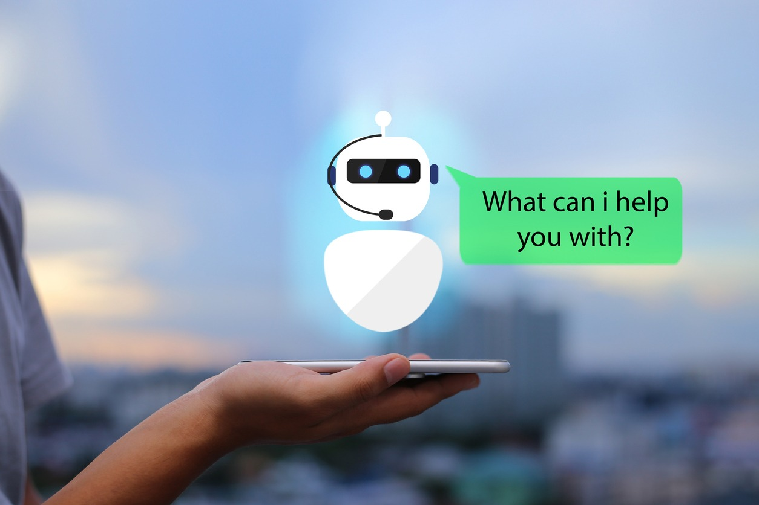
Introduction
• Growing use of voice assistants in smartphones, homes, and robotics. • Most popular assistants (Google, Alexa, Siri) need constant internet. • A fully offline voice assistant using Python.
Speech Recognition: Vosk (offline model)
Audio Input: PyAudio
Voice Output: pyttsx3 (offline TTS)
GUI: Tkinter for real-time interaction
• Highlights:
Works without internet
Responds to voice commands
Displays and logs queries/responses
Fuzzy matching for flexible input

Slide 3
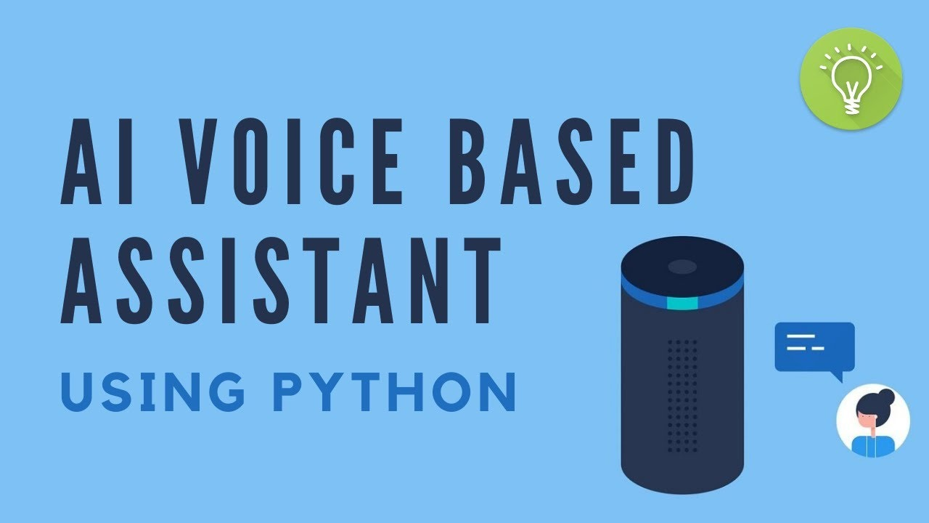
Objectives
Implement fully offline assistant.
Recognize voice commands.
Provide voice responses.
GUI for interaction logs.
Maintain query-response history.

Slide 4
Tools and Technologies Used
Tool/Library | Purpose
Python 3.x | Core Language
Tkinter | GUI
Vosk | Speech Recognition
PyAudio | Audio Handling
pyttsx3 | Text-to-Speech
difflib | Fuzzy Matching
threading | Non-blocking Operations

Slide 5
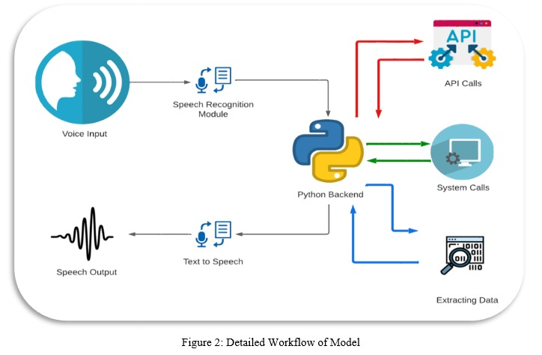
System Architecture
VoiceAssistant Class: Recognition, Response, Logging.
AssistantGUI Class: UI interface.
Fuzzy Matching: Uses difflib for similarity.
Offline Models: vosk-model-small-en-in-0.4.

Slide 6
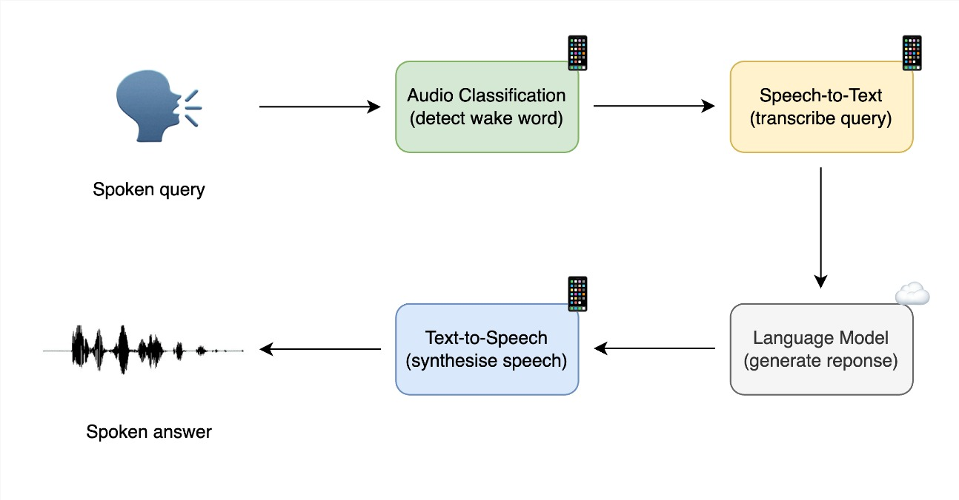
Working Principle
Waits for keyword: “assistant”.
Listens for command.
Speech → Text (Vosk).
Text matched with known commands.
Responds (TTS, GUI).
Returns to standby.

Slide 7
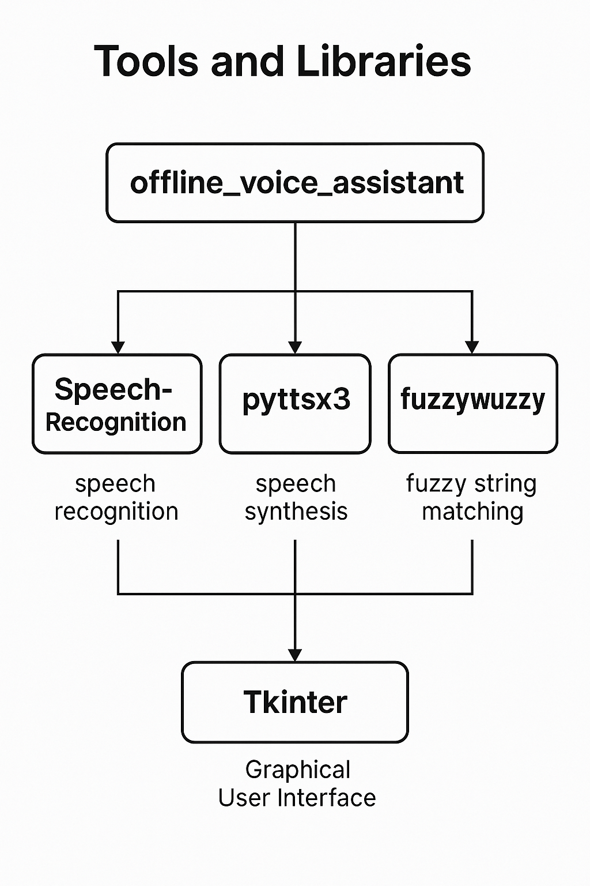
Features
100% Offline Operation.
GUI Status Display.
Fuzzy Keyword Detection.
Interaction Log File.
Text-to-Speech Response.
Robust Error Handling.

Slide 8
High-Level Differences
Feature | Earlier Version | Improved Version
Response | MP3 | pyttsx3 (TTS)
GUI | None | Yes
Logging | No | Yes
Matching | Keyword | Fuzzy Matching
Status Feedback | No | GUI-based
Activation | Basic | GUI-enhanced
Internet | Fallback | Fully Offline

Slide 9
Sample Predefined Commands
User Says | Assistant Responds
What is a cobot? | A collaborative robot...
What is AI? | AI stands for Artificial Intelligence...
Tell me a joke | Why did the robot go on vacation?...
Exit / Bye | Goodbye!

Slide 10
Advantages
No Internet Required.
Ensures User Privacy.
Lightweight.
Customizable.
Useful for ASR + GUI learning.

Slide 11
Limitations & Future Scope
Limitation | Improvement
Fixed Commands | Use External Config
No Context | Add NLP Context
GUI Exit Missing | Add Exit Button
Static Response | Use GPT or Dynamic Modules

Slide 12
Conclusion
Successfully built offline assistant.
Integrates ASR, TTS, and GUI.
Privacy-focused and customizable.
Expandable for smart home, education, or industry.

Slide 13
Thank You

